Slide 1
Android 系統架構
陳健文

Slide 2
Android 系統架構
Applications
Application Framework
Binder Inter-Process-Communication (IPC) Proxies
System Services
Hardware Abstraction Layer
Linux Kernel

Slide 3
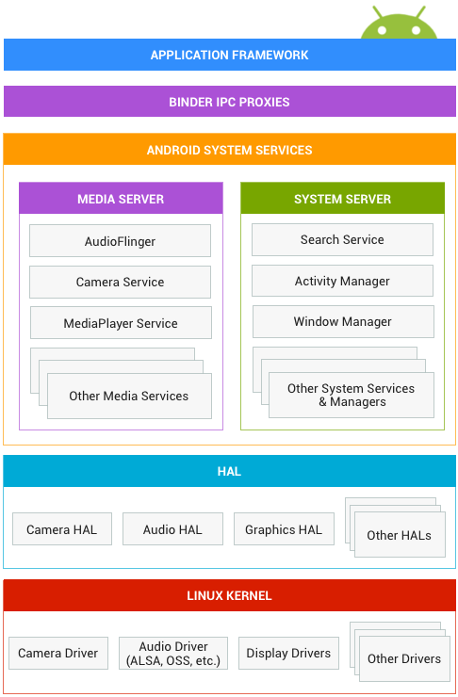

Slide 4
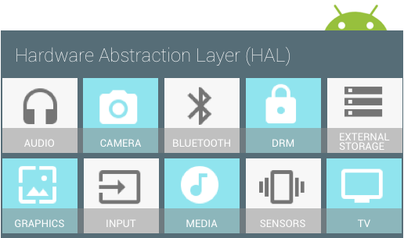

Slide 5
Dalvik
Android 虛擬機
Android 執行期
.dex(dx 編譯器)
.apk(Packager)

Slide 6
Android Runtime (ART)
Android 虛擬機
Google 開發的新式執行期
Android 4.4 就可選用
提高程式執行效率

Slide 7
Android Runtime (ART) II
Ahead-of-time (AOT) compilation
Improved garbage collection
Development and debugging improvements
Support for sampling profiler
Support for more debugging features
Improved diagnostic detail in exceptions and crash reports

